Slide 1
Sports Analyst
Sean VanWambeke
10-7-09

Slide 2
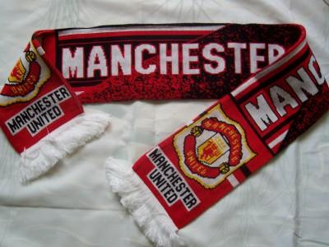
Analyst
Whenever I watch Sportscenter I always wanted to be the person that analyzes the athlete they are discussing about. Sports are the love of my life, I love to play all sports. To be able to provide everyone in the nation that is watching the information they are wondering is a good feeling. My favorite sport is soccer. I have been playing soccer since I was 6 and hope to be involved with it until I die. My brother played for about 15 years and then coached for 5 years and still trains and helps me. To be a Analyst would be a dream come true. I will be researching the nature of work, working conditions, training, qualifications, and advancement, job outlook, earnings, and related occupations.

Slide 3
Nature Of Work
Reading news stories
Providing read-ins for reporters by others
Interviewing guest
Conducting panel discussions
Reading new stories that have occurred

Slide 4
Working Conditions
The work environment is in a office
The job is mental, their isn’t much physical stuff
Lot of mental challenges
Analyst usually work for 40 hours a week
Spend a great amount of time with their clients

Slide 5
Training, Qualifications, Advancement
Degree in Journalism
University of Michigan, Central Michigan or University of North Carolina
Management, human resources, information technology, or other specialties

Slide 6
Job Outlook/Employment
Employment of management analysts is expected to grow much faster than average
Employment of analysts is expected to grow 22 percent over the 2006-16 decade
The growth of international business also has contributed to an increase in demand for analysts
Job growth for management analysts has been driven by a number of changes in the business environment that have forced firms to take a closer look at their operations
The growth of analysts are larger than any other occupation

Slide 7
Earnings
The middle 50 percent earned between $50,860 and $92,390
The lowest 10 percent earned less than $39,840
The highest 10 percent earned more than $128,330
Salaried management analysts usually receive common benefits, such as health and life insurance, a retirement plan, vacation, and sick leave
All travel expenses usually are reimbursed by the employer

Slide 8
Related Occupations
Accountants
Economists
Financial Managers
Top Executives
Market and Survey Researchers

Slide 9
Summary
I feel that this job describes a lot about me. I have a good feeling about this career choice because sports are everything that I do in my life. My whole family has played sports for a team at some point or another. I have played sports since I was 6. If I don’t become a professional athlete I would like to do something that is involved with sports a lot. A sports analyst provides information and interviews people. If I got to interview a legend in sports I would be inspired even more to do my best.

Slide 10
Works Sited Page
http://www.footballpictures.net/ For Pictures
http://www.bls.gov/OCO/ For Job
http://careers.stateuniversity.com/pages/99/Broadcast-News-Analyst.html Description

